Slide 1
IPJCOFFEE summary
From Joti Bhandari
Budsaba versteeg

Slide 2



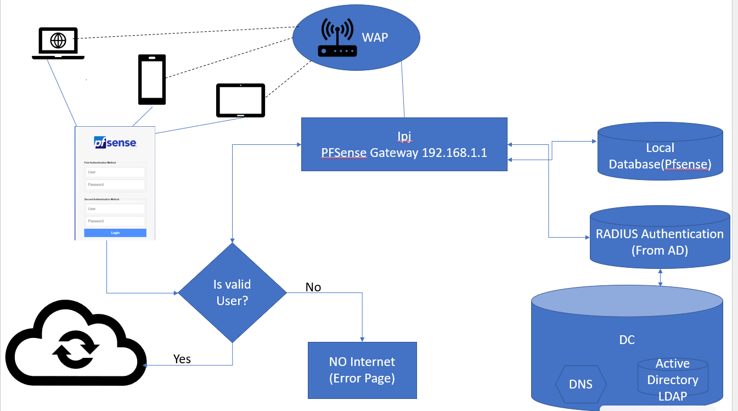
Topology used for CoffeeBytes
IT administrator of IPJCoffee has decided to use two Microsoft 2019 servers one for Active directory, DNS and DHCP and group policies and another one is radius for saving certificates for authentication. It has two layers to segment the network for security.

Slide 3
SCOPE
Subjects | Descriptions | IP Schema
DC-1 | ADDS/DNS/DHCP | 192.168.1.2/24
RADIUS | NPS | 192.168.1.3/24
pfSense | Router/Firewall/Captive Portal | (GW)/24 DHCP (NAT)
Win10-Client | Lan Testing pfSense Configuration Host | DHCP
WAP | Wireless Network | 192.168.100.0/24
Business Name | IPJCoffee
Domain Name | IPJCoffee.com
SSID | IPJCoffee
Folder Structures | MyOrg
 | Users
 | Security Groups | Management IT
 | Wireless Users
WAP (Access Point) | 1 : 80 sqm Ground Fl. = 116 sqm First Fl. = 116 sqm | 1 Access Point 1-G Fl. 1-First Fl.
Summarize everything into report
z

Slide 4
Overview
z
We IPJCyber Security Team is pleased to submit this proposal for services to support IPJCoffee.com in achieving its goal for improving customer satisfaction by providing IT Identity Access and provisioning services to achieve its goal for improving customer satisfaction by providing fully secured IT system.
Deliverable | Description
Domain Controller | Domain controller is the server used to manage user Identities and provisioning. Domain Controller is also responsible to assign user permissions and manage Active Directory.
RAIUS Server | Gateway for the traffic coming from inside or outside the network.
PFsense | Pfsense is used as a router and firewall system and used to setup DHCP Server, DNS server and WIFI access Point and VPN server.

Slide 5
Hardware and Software /OS
Materials to be supplied by IPJCoffee.com | Due Date*
WIFI modem | 30/Apr/2023
Physical computer 3 | 30/Apr/2023
WINDOWS SERVER 2019, Pfsense Server, win 10 license | 30/Apr/2023
z

Slide 6
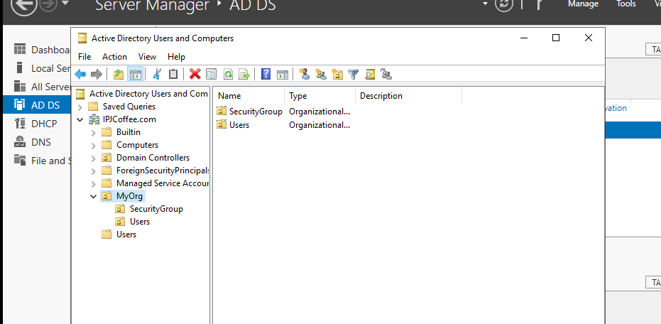
DC_ Windows Server 2012
z
AD Users and Computers
IP: 10.0.0.2
Network: LAN Segment

Slide 7
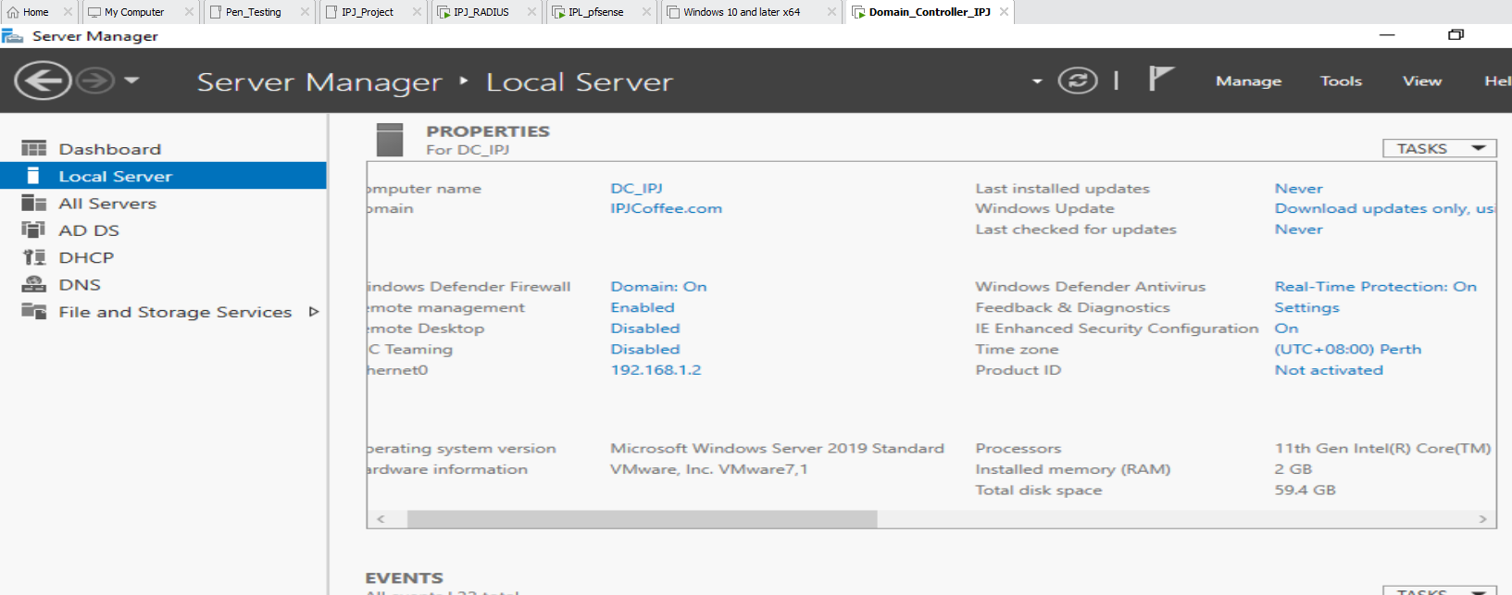
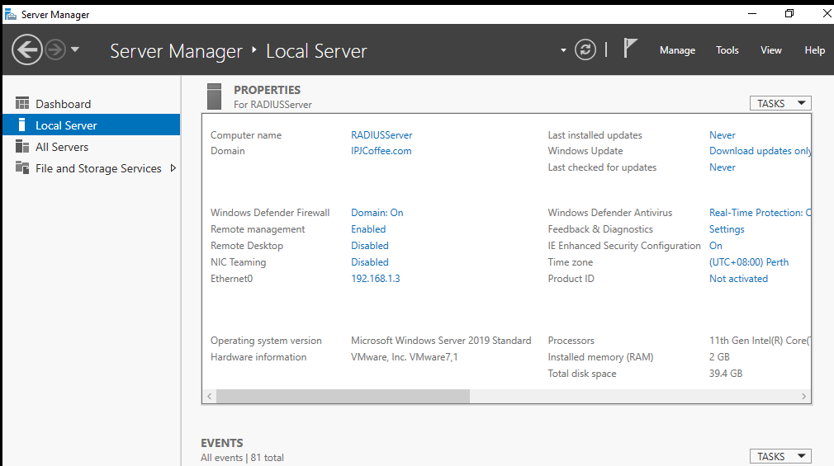
Configure IPJCoffee Domain controller with IP 192.168.1.2
Configure IPJCoffee RADIUS with IP 192.168.1.3

Slide 8
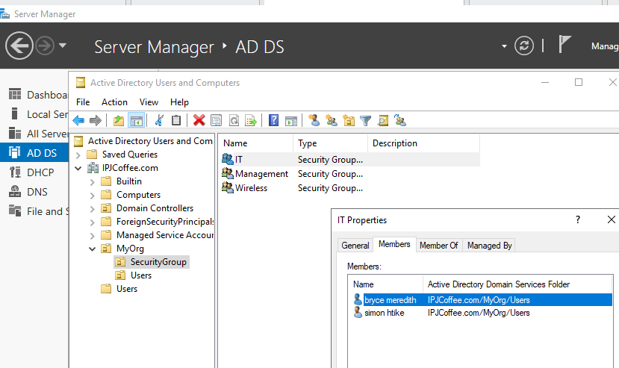
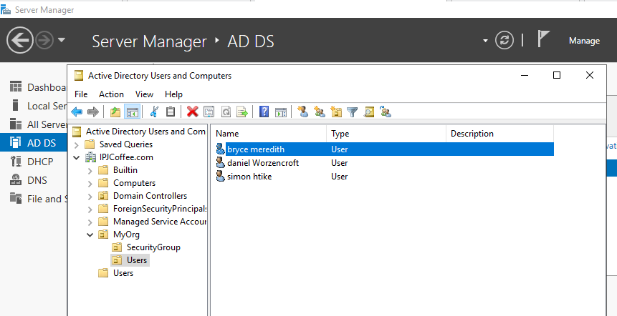
Users

Slide 9
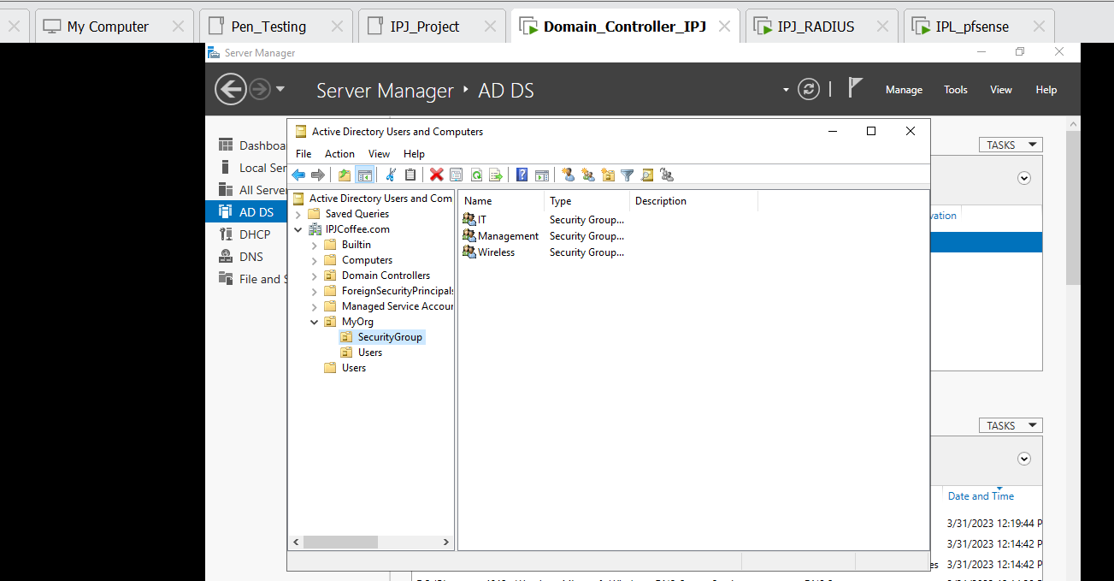
Organisation unit: Security Group
IT
Management
Wireless

Slide 10
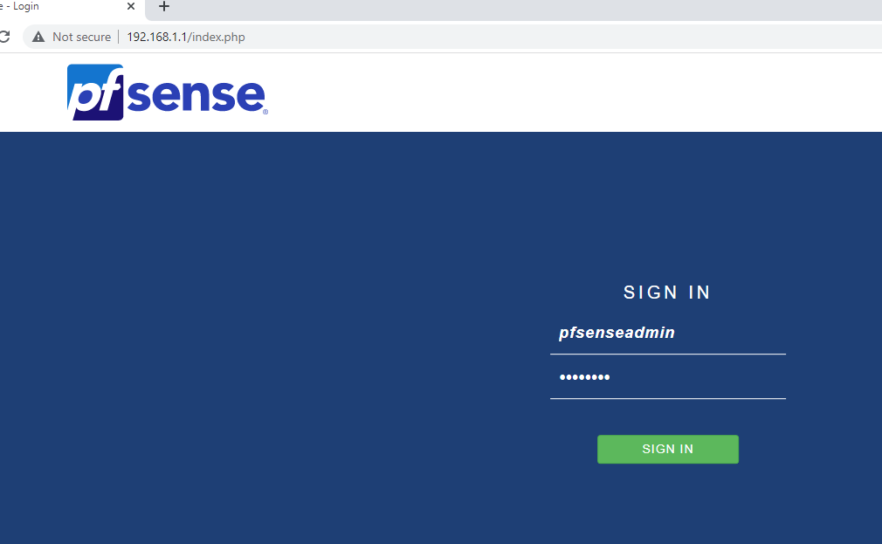
PFSENSE

Slide 11
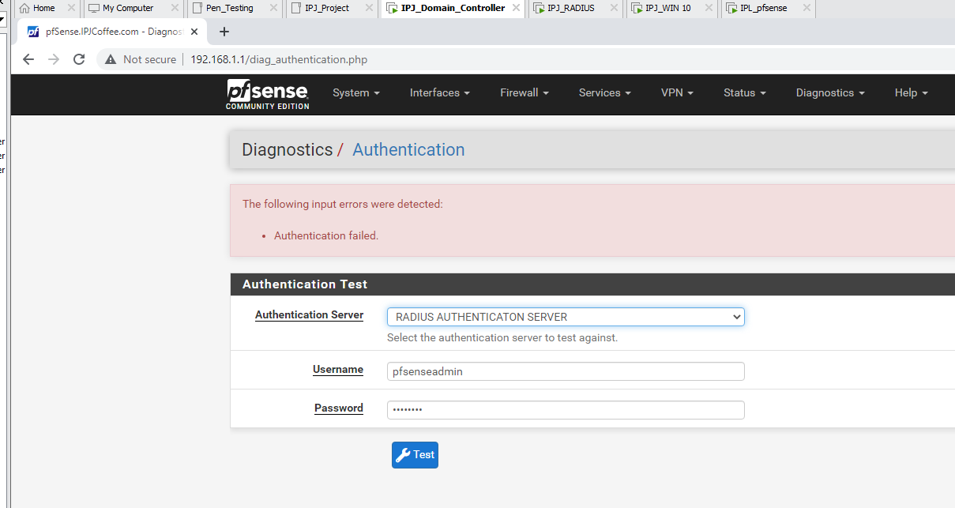
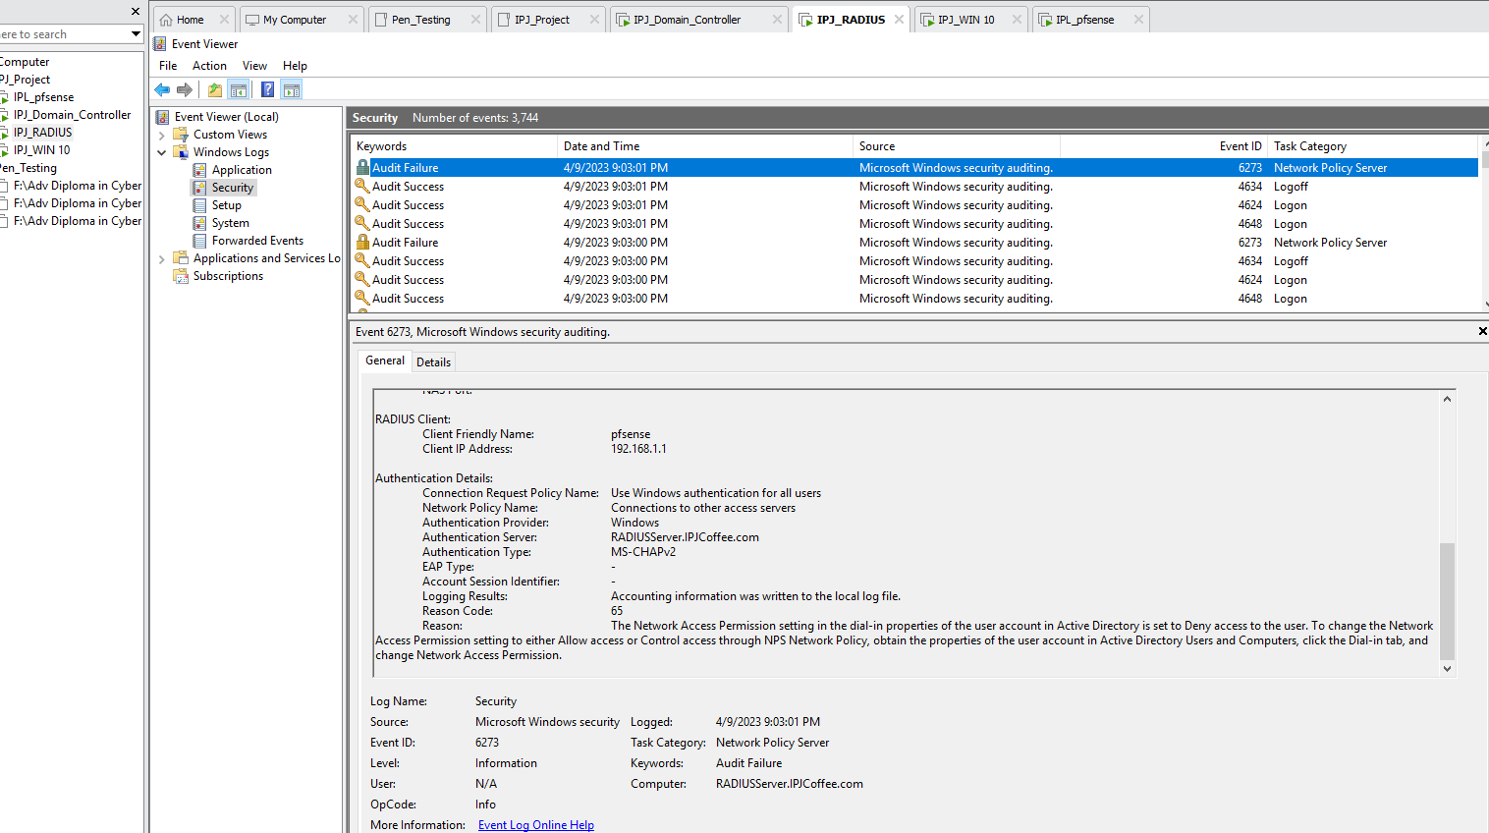
Test Login authentication
Event viewer

Slide 12
Wireless

Slide 13
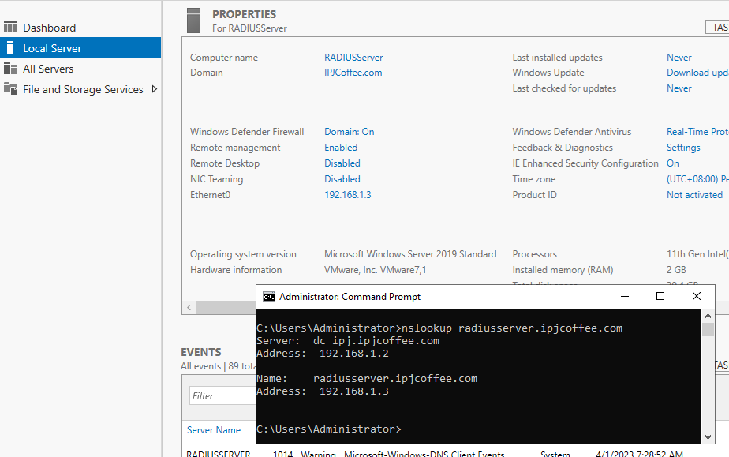
On radius configure WAP 1 and WAP2
RADIUS client:
IP: 192.168.100.100
Name: IPJWAP1
Complex password
IP 192.168.100.101
Name: IPJWAP2
Complex password

Slide 14
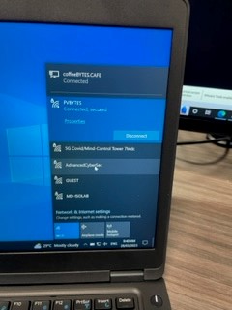
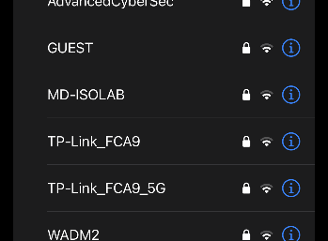
Wireless-Implementation
z

Slide 15
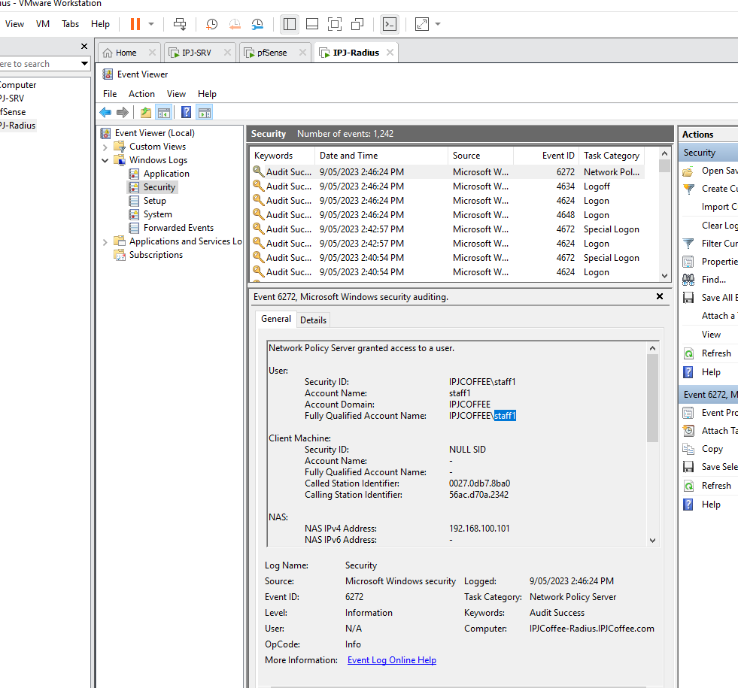
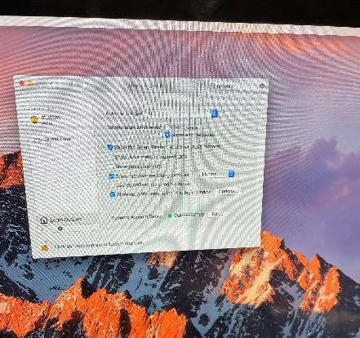
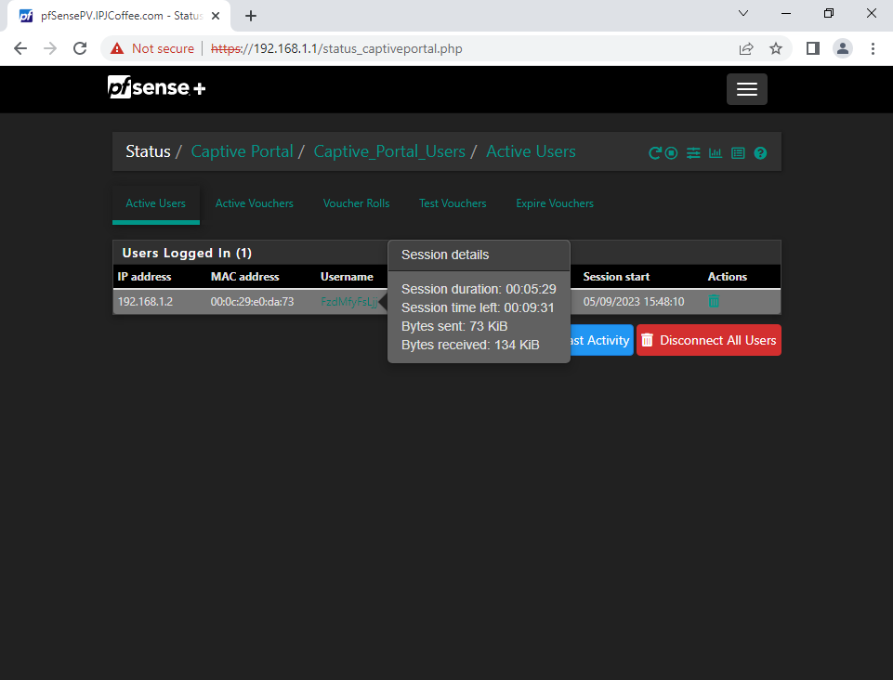
IT Management Team will be able to check through the events logs of authenticated users logging into network system.
z

Slide 16
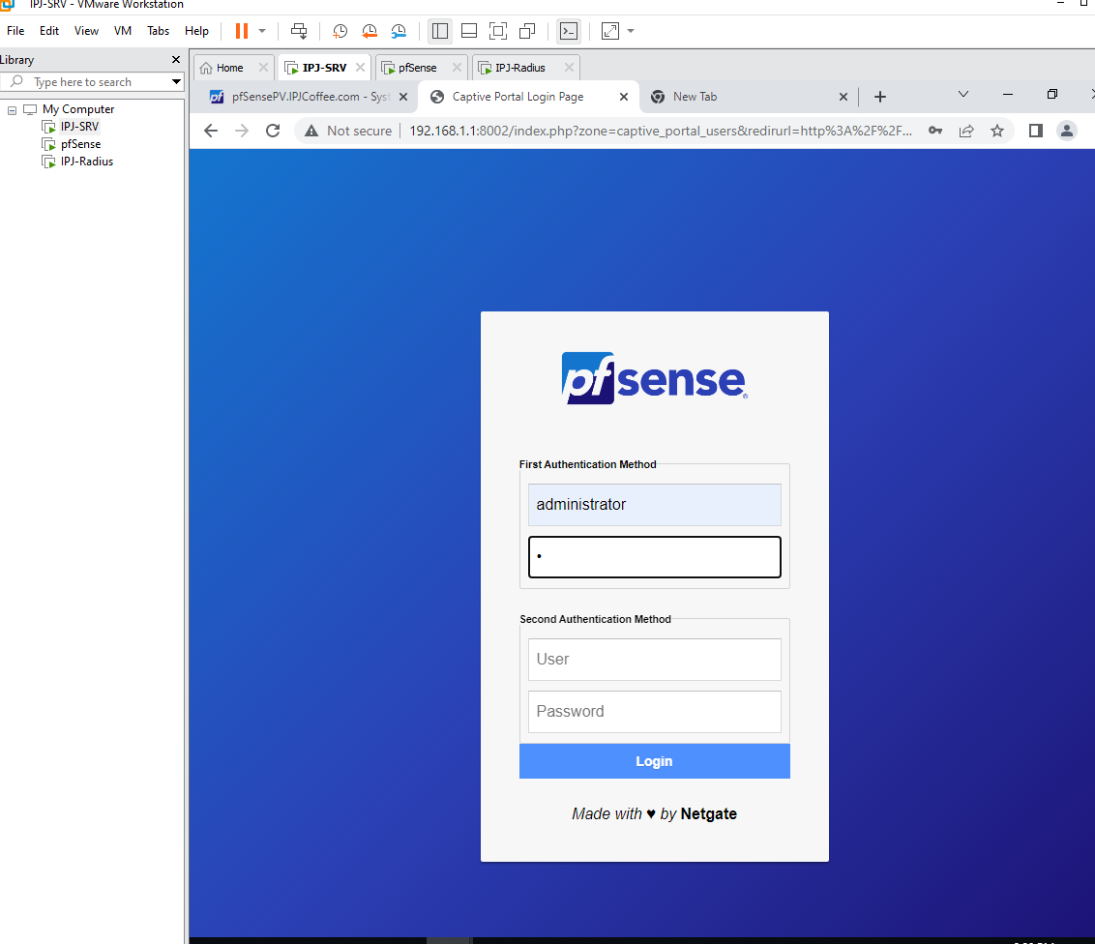
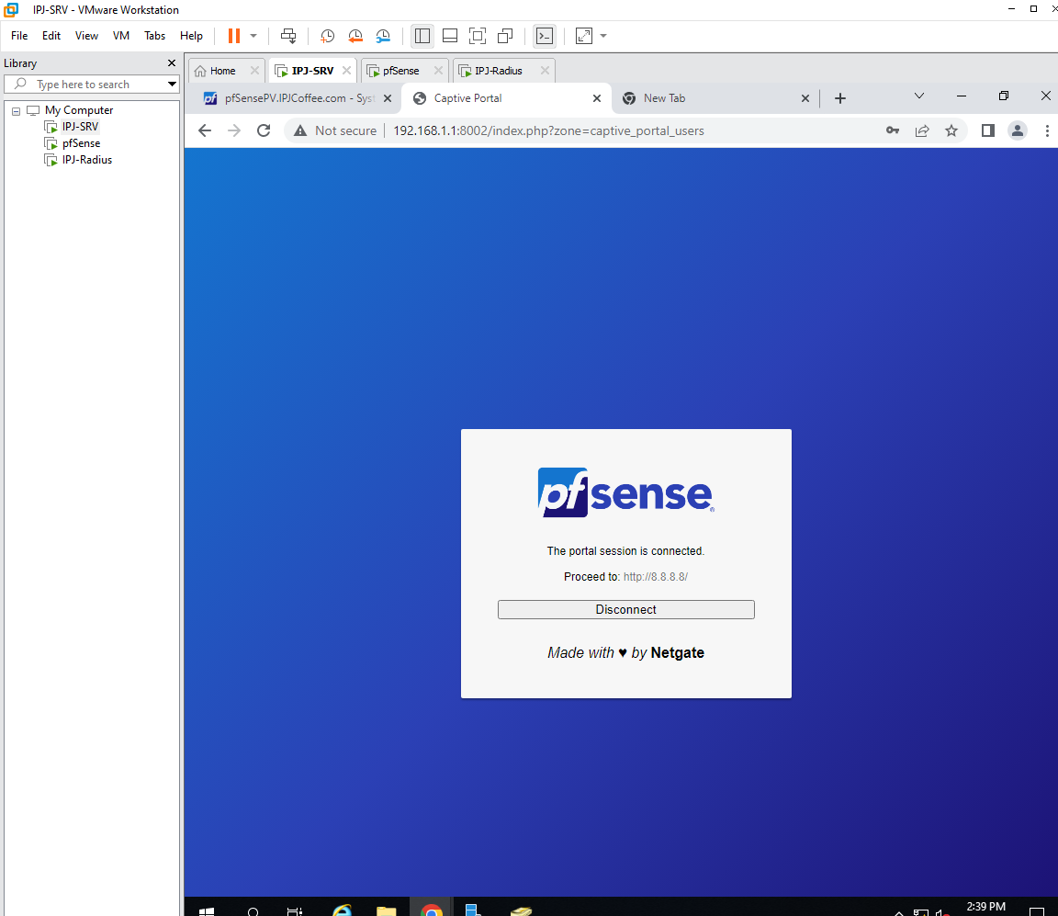
pfSense Captive Portal has been implemented for users to sigh in
z

Slide 17
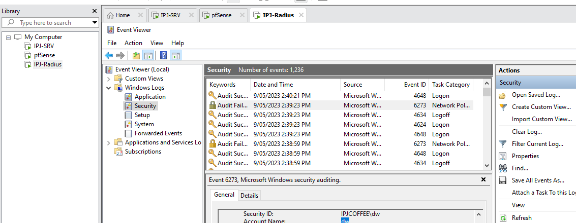
IT Management Team can monitor the network activities through the events logs
z

Slide 18

FOLDER SHARING
z

Slide 19
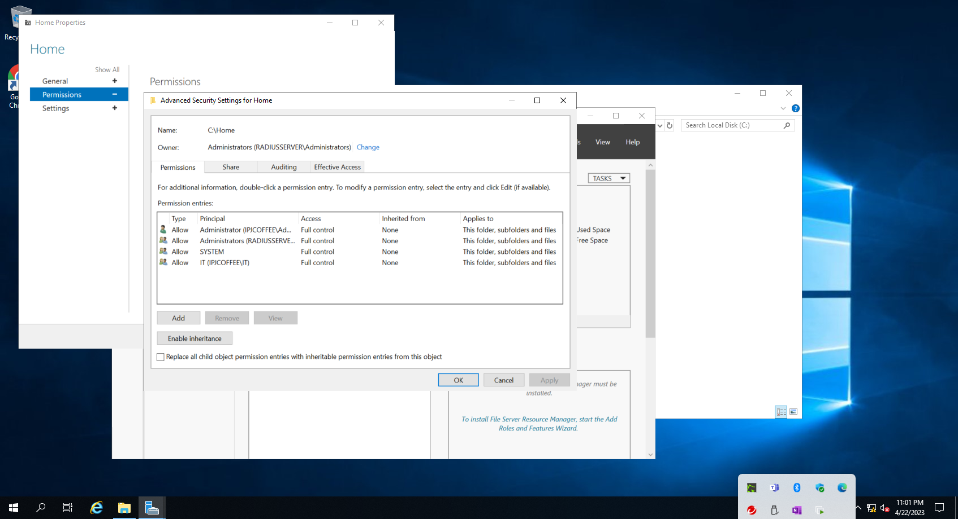
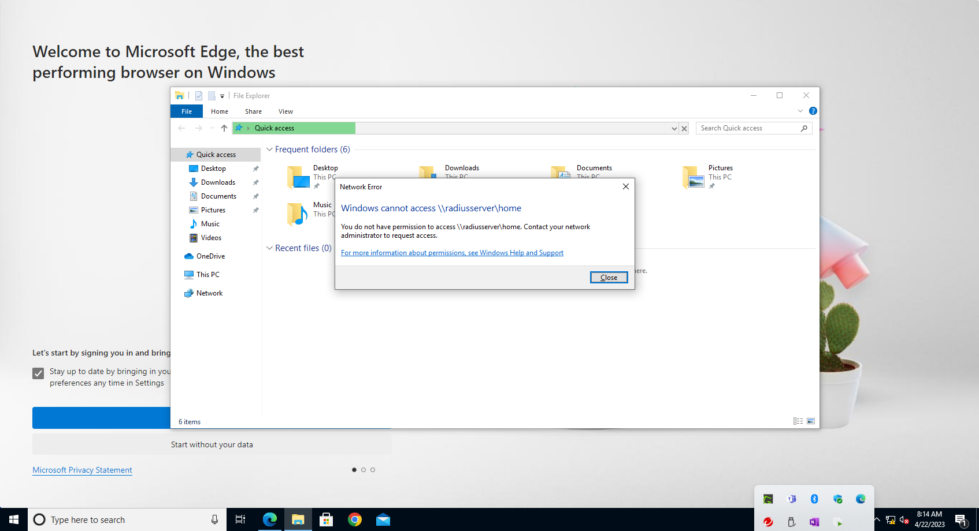
Share folder in RADIUS
z
c :\ drive, Client user sam trying to access \\radiusserver\home folder

Slide 20
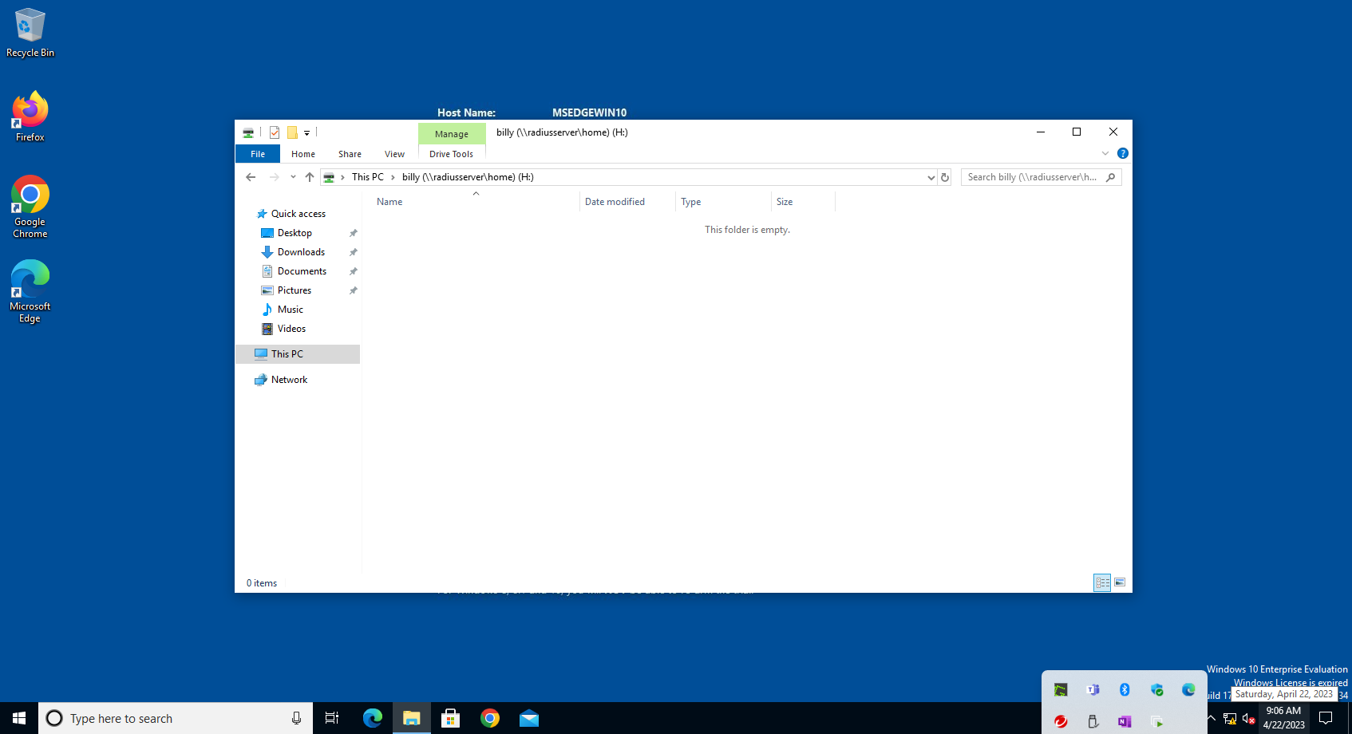
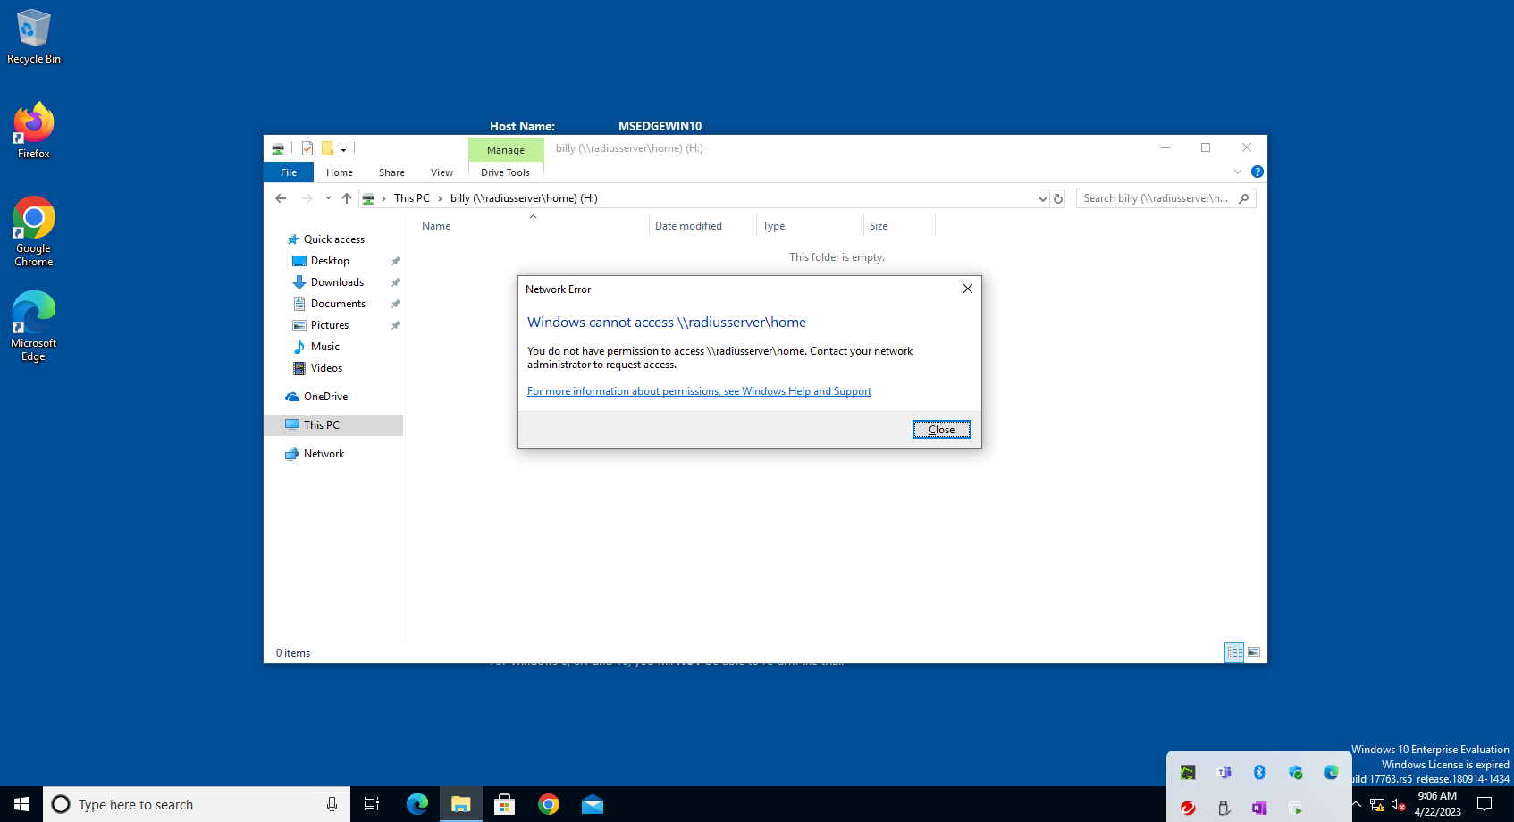
User:billy have access h drive
z
When user trying to open path:
\\radiusserver\home

Slide 21

Physical SECURITY PROCEDURE
z

Slide 22
Physical SECURITY PROCEDURE
z
All network servers shall be in a locked or secured in a locked room. All network server rooms shall have fire extinguishers located within the room. Network Technicians shall be aware of the location of the fire alarm. There should be smoke detector installed in the room. The network server room should be monitored for temperature. A logging system shall be set up to document any visitors to the server room. All visitors to the server room or LAN/Phone shall be always escorted. No drinking is allowed around computer equipment. Sensitive information shall not be stored on portable computers that are taken outside of secured areas. Do not leave confidential information on desks after working hours or in rooms that are un-attended. When dealing with confidential information, ensure that no one is watching over your shoulder. This precaution should also be taken when typing in passwords. Attended operation is required when printing confidential information to an unsecured.

Slide 23
VLAN Implementation
z

Slide 24
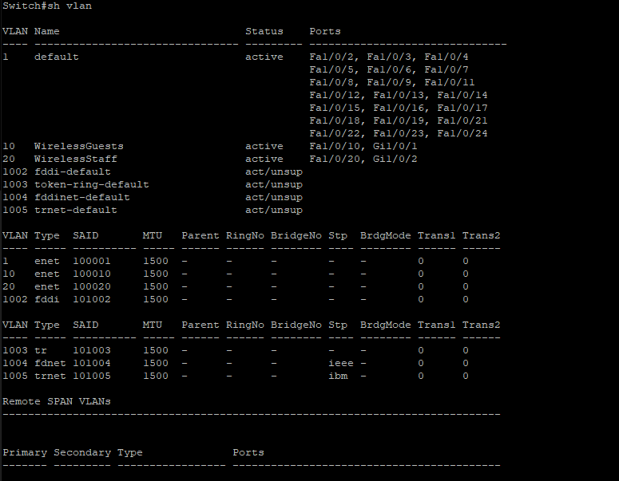
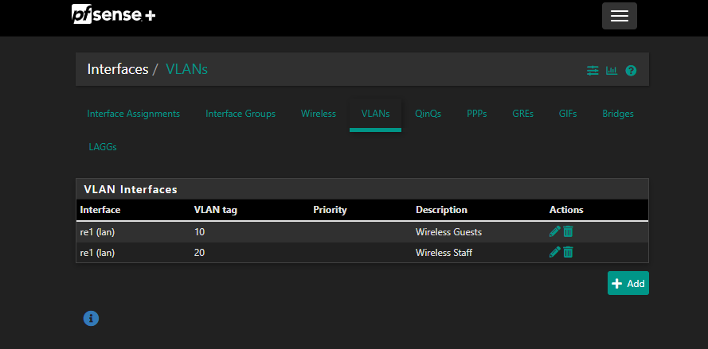
Create two interfaces WAN and LAN
z

Slide 25
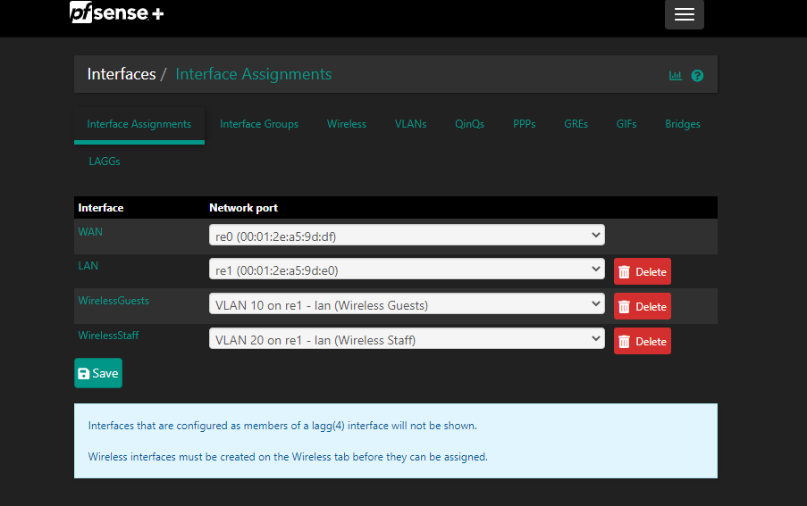
Create the 2 VLANs for wireless guests and wireless staff

Slide 26
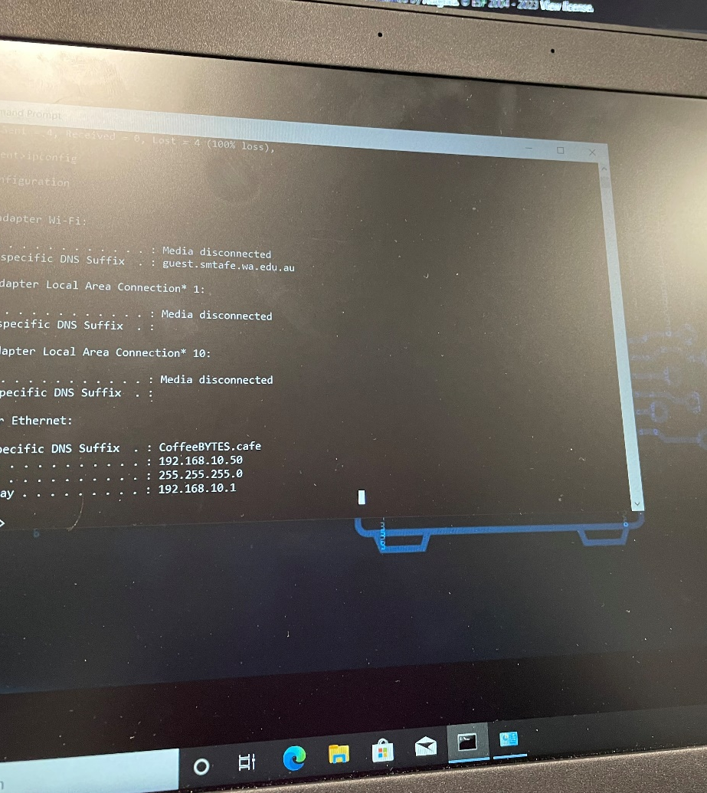
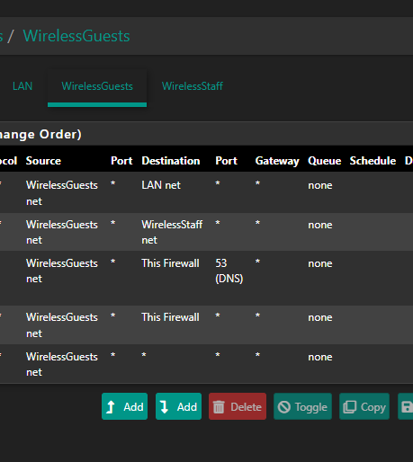
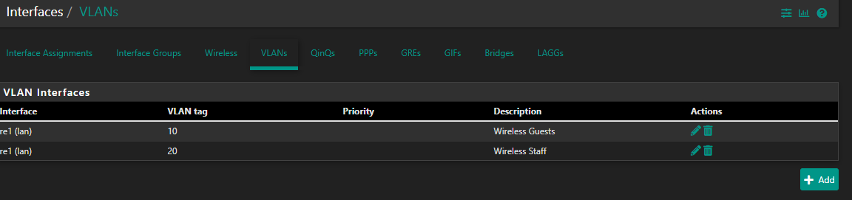
VLAN Logs
z

Slide 27

Cattive Portal pfsense+
z

Slide 28
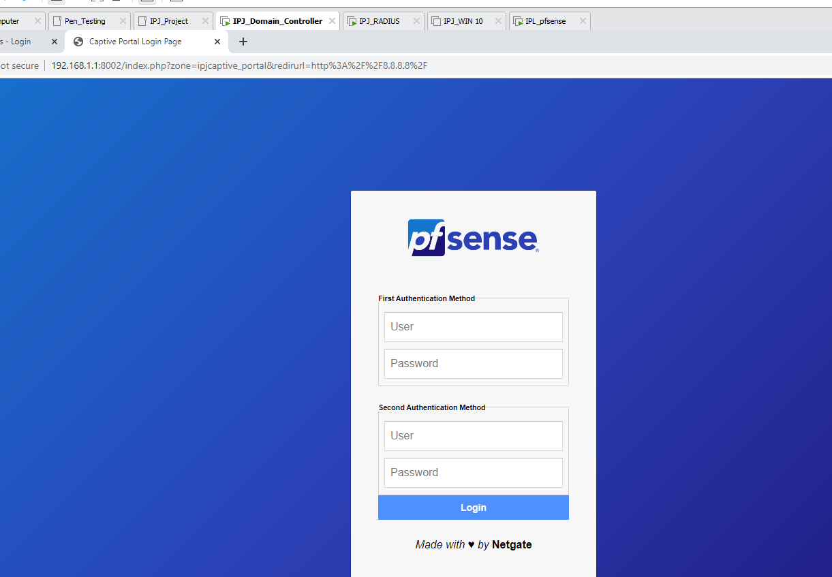
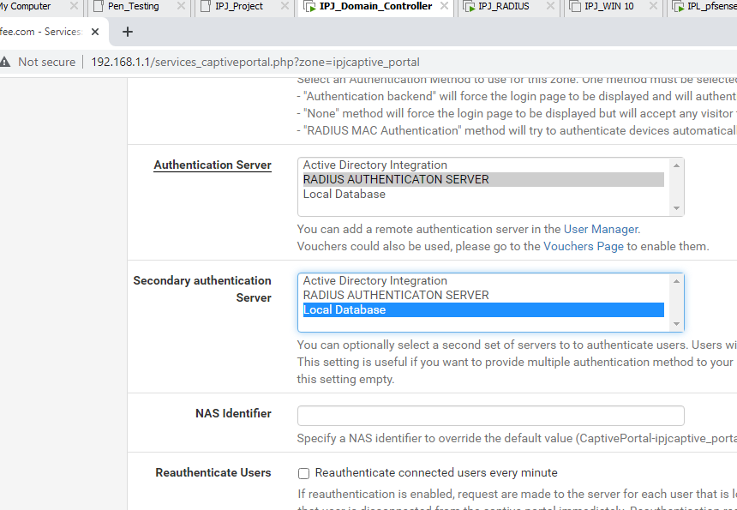
Add Captive Portal
z

Slide 29
Conclusion
z
IPJCOFFEE Network structure is a secured infrastructure. IPJCOFFEE Managers need to demonstrate the security practice demos for the employees like: “how long the password should be”, “password formats examples”, do not install unknown software which could affect the network.
Auditing System helps to add logs to the file for monitoring the network. Administrators need to collect and analysis the data for suspicious events and use the training document for the employees.

Slide 30
Recommendations
z
we recommend and implement password policy users to change their password after 60 days to mitigate the problem that would occur if an attacker acquired the password hashes of your system and were to break them.
There should be a scheduled backup program for all the clients and server data. A virus or accidental system crash could delete important data from computers, so backup of data is only way to recover organization important data. We have implemented snot for the traffic control. We recommend IPJCOFFEE to integrate vulnerabilities scan system such as Splunk and would help to find more recent threats for security in IPJCOFFEE.

Slide 31

Mitigation Strategies
z

Slide 32
ACL (Firewall Rules)
z
Configured on routers to control traffic either allow or deny into the network system based on various criteria.
Give network admin more control over which type of traffic entering the network, the good or bad where respond will be in according.

Slide 33
IDS/IPS
Intrusion Detection System (IDS) helps detect any suspicious/anomalies traffic and send alert to network administrator to analyze.
>Intrusion Protection System, not just detect but act upon suspicious traffic before entering network system.
Both functions generate “Alerts” to network admin to act in according or respond to the incidents, just in time to prevent any harm done.

Slide 34
VLAN
Network segmentation helps protect the network in case of breach or attack which will only damage to the specific one, not the whole system. Easy to implements and analyze network security policies.
Slowdown the attack, network admin has extra time to see through options to mitigate.

Slide 35
Lansweeper
Network Auditing software or IT Asset Management, showing status of network systems in both hardware/software indicating what need to be done to get the network going without incidents.
Providing the overall network health status which increase visibility to network admin should anything unusual occurs.

Slide 36
Thank You From: Joti Bhandari Budsaba versteeg

